Slide 1
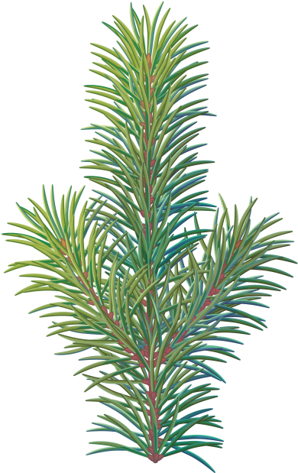



43rd Annual
Tall Tree Awards
Presented by:
APRIL 20, 2023
Oshman Family JCC | 3921 Fabian Way, Palo Alto

Slide 2




Thank You to our
Generous Event Sponsors!

Slide 3
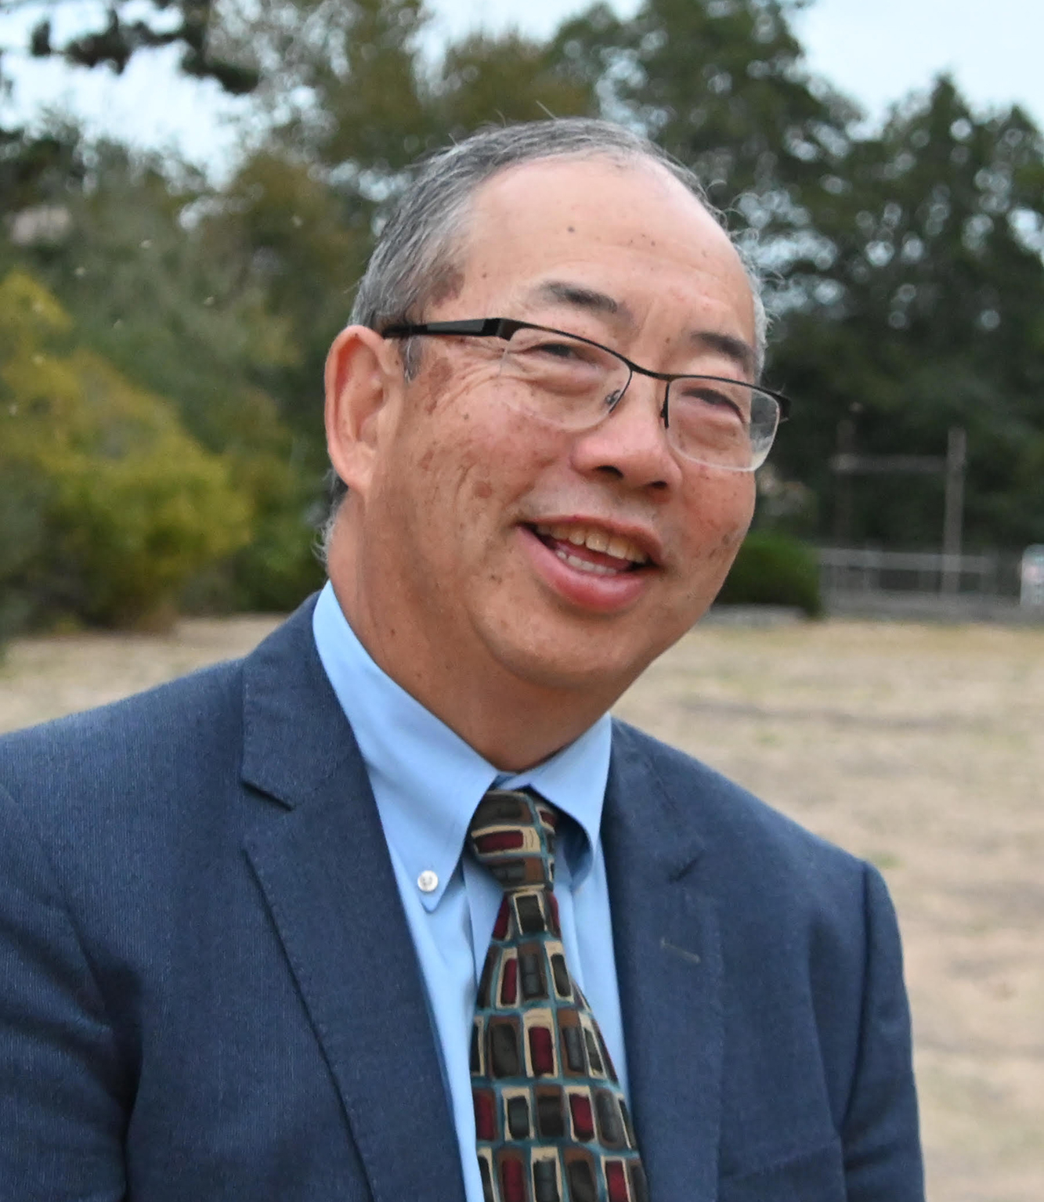

Outstanding Citizen Volunteer
Bruce Gee

Slide 4

Outstanding Nonprofit
DreamCatchers

Slide 5
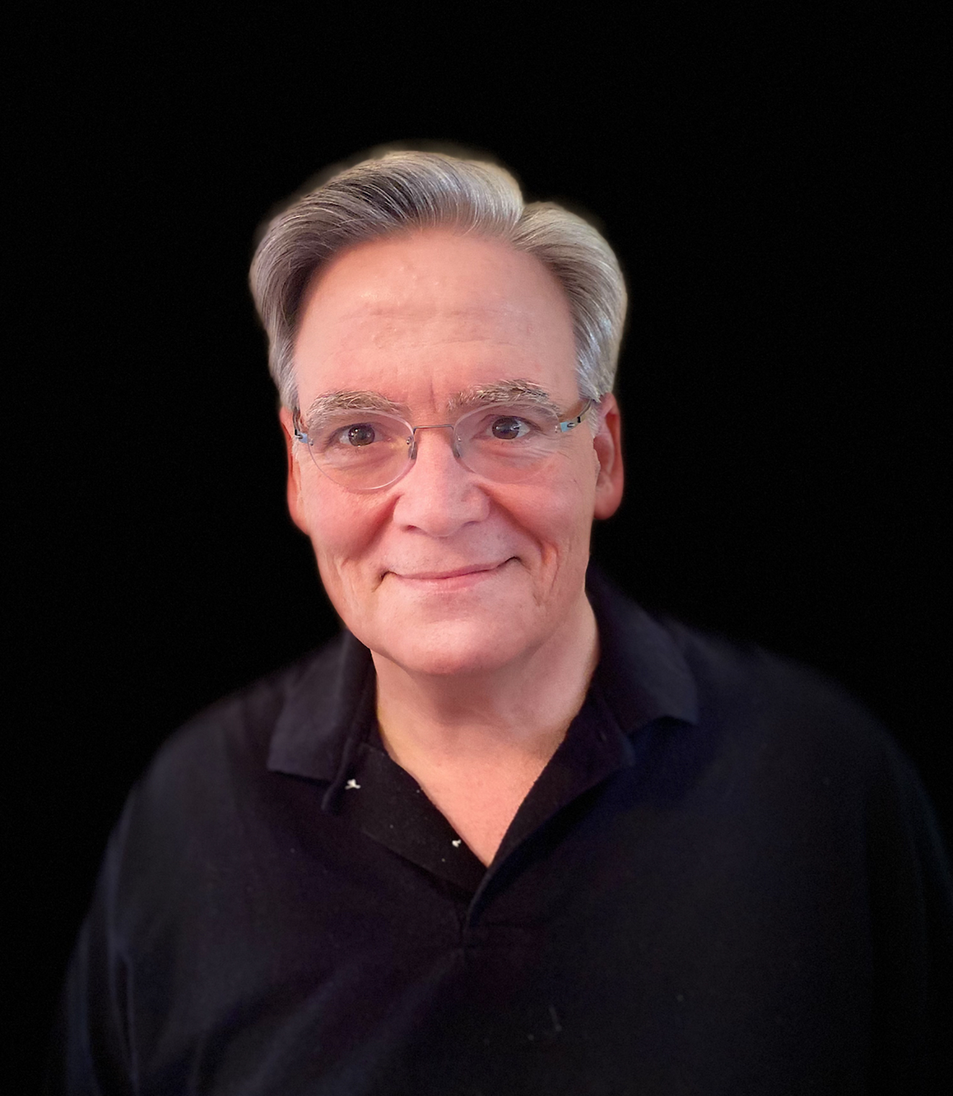
Outstanding Professional
Bill Liberatore

Slide 6

Outstanding Business
Coupa Cafe

Slide 7
Thank You to our
LEADERS CIRCLE

Slide 8


Slide 9




Slide 10
Thank You to our
CHAMBER BENEFACTORS

Slide 11







P A L O A L T O
P A L O A L T O

Slide 12





Slide 13






Slide 14






Slide 15








Slide 16
Thank You to our
TABLE SPONSORS
WizChinese, Webster Financial Corporation,
Palo Alto Community Fund, Palo Alto Rotary Club,
Stanford University, Stanford Medicine,
Heritage Bank of Commerce, Elizabeth F. Gamble Garden,
City of Palo Alto, ADAs Cafe, Castilleja School

Slide 17
Previous Tall Tree Award Recipients
Outstanding Citizen Volunteer
2022 Bruce Gee
2021 Roger Smith
2020 Hal Mickelson
2019 Paula Collins
2018 Allan & Mary Seid
2017 Winter Dellenbach
2016 Olenka Villarreal
2015 Fran Codispoti
2014 Cathy Kroymann
2013 Becky Beacom
2012 Alison Cormack
2011 Bill Alhouse * &
Jane Alhouse Gee
2010 Mary and Victor Ojakian
2009 Carolyn Tucher
2008 Megan Swezey Fogarty
2007 Gary Fazzino*
2006 Barbara Spreng
2005 Mike Cobb
2004 Julie Jerome
2003 Lanie Wheeler
2002 Lois Hogle *
2001 Walter Hays
2000 Nevida Butler
1999 Sam Webster*
1998 Madeline J. Stein
1997 Boyd C. Smith
1996 Bill & Carolyn* Reller
1995 Jack Sutorious *
1994 Larry Klein
1993 Stephen W. Player
1992 Frances Arrillaga *
1991 Gretchen Emmons
1990 Sidney Mitchell *
1989 Aggie Robinson *
1988 Jim Burklo
1987 Debbie Mytels
1986 James Stone *
1985 Anne Warner Cribbs
1984 Zenna E. Higgins *
1983 Virginia Lee*
1982 Alan Henderson *
1981 Leon "Skip" Glover *
1980 Queene Amirian *

Slide 18
Previous Tall Tree Award Recipients
Outstanding Nonprofit Company or Organization
2022 DreamCatchers
2021 Peninsula Open
Space Trust
2020 Palo Alto Players
2019 La Comida de California
2018 Ada's Café
2017 Lucile Packard
Children's Hospital
at Stanford
2016 Kiwanis Club of
Palo Alto
2015 Acterra
2014 Palo Alto Community
Child Care
2013 Bay Area Cancer
Connections (Breast
Cancer Connections)
2012 Foundation for a
College Education
2011 Youth Community
Service (YCS)
2010 Downtown Streets
Team
2009 Abilities United
2008 Canopy, Trees for
Palo Alto
2007 Christmas Bureau of
Palo Alto
2006 Children’s Health
Council
2005 Adolescent Counseling
Services
2004 Palo Alto Housing
Corporation
2003 YMCA of the Peninsula
2002 Hidden Villa
2001 Environmental
Volunteers
2000 Mid-Peninsula Bank **

Slide 19
Previous Tall Tree Award Recipients
Outstanding Nonprofit Company or Organization
1999 Palo Alto Medical
Foundation
1998 Palo Alto Sanitation
Company
1997 Palo Alto Children’s
Theatre
1996 Palo Alto Police
Department
1995 Gleim the Jeweler
1994 TheatreWorks
1993 Hobee’s Restaurants
1992 Gray Cary Ware &
Freidenrich (Ware &
Freidenrich) **
1991 Sun Microsystems **
1990 KARA
1989 Families in Transition **
1988 Neighbors Abroad
1987 Winter Lodge
(The Trust for
Community Skating)
1986 Career Resource Center
(Resource Center for
Women)
1985 Palo Alto Jaycees
1984 Avenidas (Senior
Coordinating Council)
1983 Palo Alto Elementary
School Closure
Committee
1982 Hewlett-Packard
Company ***
1981 Palo Alto Host
Lion’s Club
1980 Roche Bioscience
(SyntexCorporation) **

Slide 20
Previous Tall Tree Award Recipients
Outstanding business
2022 Coupa Cafe
2021 Homewood Suites
2020 Premier Properties
2019 KEEN Garage
2018 SAP
2017 Presidio Bank
2016 Palo Alto Bicycles
2015 Stanford Federal
Credit Union
2014 Sheraton Westin Hotels
2013 Wilson Sonsini
Goodrich Rosati
2012 Whote Foods Market
2011 University Art Center **
2010 Stern Mortgage**
2009 Ming's Chinese
Restaurant **
2008 IDEO
2007 JJ & F Food Store **
2006 Lockheed Martin
2005 Compadres **
2004 Garden Court Hotel**

Slide 21
Previous Tall Tree Award Recipients
Outstanding Professional or Business Person
2022 Bill Liberatore
2021 Pastor Paul Bains
2020 Cammie Vail
2019 Dr. Enoch Choi
2018 Shashank Joshi
2017 Jim Shelby
2016 Richard "Dick" Peery
2015 Sharon Keplinger
2014 Dennis Burns
2013 Ray Bacchetti *
2012 John Barton
2011 Jim Baer
2010 Roxy Rapp
2009 Carroll Harrington *
2008 Linda Lenoir
2007 Chop Keenan
2006 Dr. Don Barr
2005 Tony Carrasco
2004 Sandra Pearson
2003 Joe Davis, MD
2002 Jay Thorwaldson
2001 Warren Thoits *
2000 Elliot Margolies
1999 Lupe Garcia
1998 Larry Hassett
1997 Margo Dutton
1996 James R. Brown
1995 Carl Schmitt *
1994 Marge Collins *
1993 Sylvia Seaman
1992 Gary Cavalli
1991 Loretta Green
1990 William Johnson
1989 Andy Doty
1988 John Northway
1987 Hans Wolf *
1986 Kay Philips
1985 Sarita S. Berry
1984 Dr. Bernard S. Aarons*
1983 Jack Wheatley*
1982 Leonard Ely *
1981 Leon "Skip" Glover *
1980 Betty Wright *) **

Slide 22
Previous Tall Tree Award Recipients
SPECIAL CENTENNIAL RECOGNITION
1994 Stanford University
GLOBAL IMPACT AWARD
2021 Dr. Yvonne "Bonnie"
Maldanado
2021 Dr. Sara Cody
2017 Gordon and Betty Moore
2013 John Hennessy
COMMUNITY LEADERSHIP AWARD
1990 C.W. Roddy

Slide 23
Thank you

